Slide 1
TUK-2021
DEPARTMENT OF ENTREPRENEURSHIP DEVELOPMENT
BUSINESS PLANNING DEVELOPMENT

Slide 2
Introduction: Outline
Definition of business plan
Importance of Business Plan
Contents of a Business Plan
Summary of major components
Chapter one of Business Plan

Slide 3
Course Purpose
To familiarize students with concepts of entrepreneurship, new venture creation and management and help them develop and systematically apply the entrepreneurial way of thinking to create opportunities and successfully bring them to market
Key to the course is building entrepreneurial attitudes and behaviors among students that will lead to creative solutions, at personal, and within organizational environments.

Slide 4
Introduction/Definition of Business plan
Business planning is the key to business success.
It is a written document which spells out the goals and objectives of a business and clearly outlines how and when they will be achieved.
It is a picture or a model of what the business is, where it is going and how to get there.

Slide 5
Importance of Business Plan
It is used as a financing tool. It provides information which forms a basis for obtaining finance.
It is used as a guide (blueprint). It provides guidelines for starting and operating a business.
A business plan is used to reduce problems in the business (fire fighting tool). By preparing a business plan, problems can be anticipated and decisions as to how they should be avoided can be determined.
A business plan forces the owners to justify their plans of action (prove the validity of their actions).

Slide 6
Importance of Business Plan
A business plan helps to test ideas on paper. It is much better to prepare a business plan and find out that the business is likely to be unprofitable than to start the business.
A business plan indicates the owners’ ability and commitment. It assists in communicating the affairs of a business to interested parties e.g. loan officers, potential partners and suppliers.
It is used as a selling tool to outsiders.

Slide 7
Contents of a Business Plan
1. Cover page
It contains name of the business, address, , name(s) of the owners, the organization to which the business plan is to be presented and the date of presentation.
2.Table of contents
Shows the reader of the plan where he can directly get a certain items within the plan without necessary going through every page

Slide 8
Contents of a Business Plan
3.Executive Summary
A short and brief description of the business and contains all the major components in short statements.
It is the first information the reader will encounter, hence should be interesting with proper emphasis placed on important aspects.
4.Business Description
It contains a comprehensive description of the business. It shows the name and type of business and where it will be located.
The form of ownership, the type of products and services intended for sale, the goals and objectives of the business, the entry strategies and the growth potentials.

Slide 9
Contents of a Business Plan
5.The marketing Plan
This involves a description of the target market, the existing possible competition, advertising and promotion of the products, the pricing strategies and the sales tactics to be used and type of distribution channels(s) used.
6.Management and Organization Plan
This section involves an outline of the key personnel and other personnel of the business and their duties and qualifications.
It also highlights the recruitment, training and promotion procedures and their salary policies.

Slide 10
Contents of a Business Plan
7. Production and operation plan
This section describes the actual facilities required for the business operation e.g. tools and equipment, premises, labour etc.
The required steps for producing the products or for offering the services should be clearly stated to show the operation process.
8.Financial plan
This consists of realistic financial forecasts or projections.
It should consist of the start-up capital and their sources, the start-up costs, expenses per month and the cash flow in and out of the business.
Careful prepared financial statements represent the actual financial achievement expected from the business plan.

Slide 11
Contents of a Business Plan
9.Appendix
Contains valuable information that is not contained in any of the sections of the plan,
It includes names of references, advisors, drawings, agreements and any other materials that support the plan

Slide 12
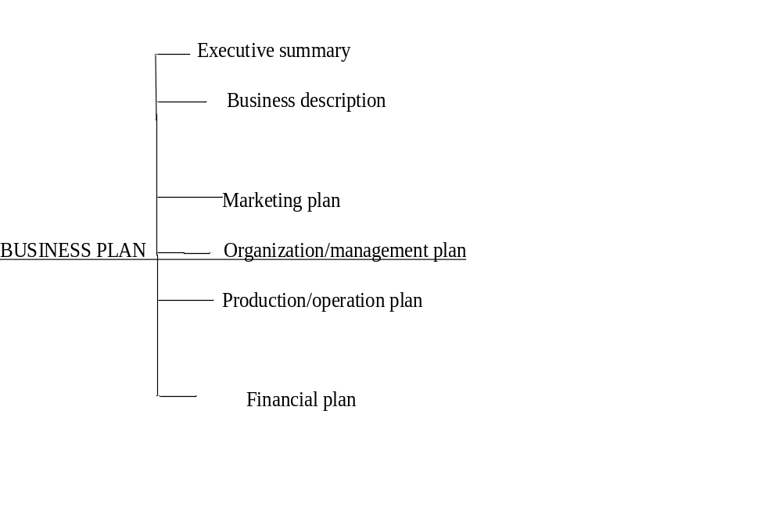
Major components of a Business Plan

Slide 13
Chapter one: Business Description
1.1Business sponsors
Provide brief background information about the owner(s) of the business in relation to name(s) of owner (s), the education level, skills and experience relevant to the operation of the business.
1.2 Business Name
Identify a suitable name for your business and give its meaning.
Give a name which is relevant, easy to remember and appealing to customers.

Slide 14
Chapter one: Business Description
  1.3 Business Location and address.
Describe your business physical address by giving the name of the city/town, street/avenue building, and floor and room number.
In some areas where these do not exist, identify your business location in relation to significant structures of the area. e.g. hospital, petrol station police station, post office, schools churches etc. provide also a postal address for your business including a telephone number where possible.
State at least 5 reasons for choosing that location.
You may illustrate your business location using a sketch map.

Slide 15
Chapter one: Business Description
  1.4 Form of Business Ownership
Indicate how the business is to be owned e.g. sole proprietorship, partnership or private limited company. Show the advantage of choosing any of the above.
1.5 Type of Business
Describe the activities to be carried out in the business e.g. services, manufacturing, retailing, wholesaling etc. differentiate the activities into major and minor activities.
Describe the status of the business e.g. start-up, already existing, Franchise etc.
NOTE; All of you choose start-ups.

Slide 16
Chapter one: Business Description
  1.6 Product(s) and Service(s)
Name and describe the products(s) or service(s) to be offered by the business in detail, giving the physical features of the product(s) such as various types, colors, sizes, quantities, shapes etc.
Explain the competitive advantages that your products or services will have over those of your competitors, which will justify why your customers will buy from you but not from them.
In case of service(s), describe the quality, promptness, type of services to be offered etc. Show the competitive edge of your service.

Slide 17
Chapter one: Business Description
  1.7justification of Business opportunity
Give at least 5 good reasons why you have decided on this particular business opportunity/idea.
Consider the following;
  Specific needs that your business will satisfy
  Roles of your business to the local community
  Specific qualities, skills abilities and experiences that you have to enable you run this business
  What the environment have that will enable the business set up

Slide 18
Chapter one: Business Description
  1.8 Industry
Industry is a cluster of businesses, producing the similar kinds of products/services and serving similar market segment to solve similar customer needs.
Identify the industry your business falls under.
Describe this industry in detail, in regard to size, business trends, technology, capital required, and amount of competitions projected, and future performance of the industry.
(Note: information on all industries in the country is available from Economics publications – do your research).

Slide 19
Chapter one: Business Description
  1.8 Industry…. contd’
Consider the following;
In which industry does your business belong?
E.g matatu business is in the transport industry
Analyze the industry you have identified in terms of ; brief history, size, trends and characteristics of the industry

Slide 20
Chapter one: Business Description
  1.9 Business Goals
Goals are your aims or your expected outcomes. State your goals in the short-term and long-term.
Your business goals must be specific, measurable, achievable, realistic and time-phased (SMART).
Give at least 6 goals. (3 in short-term and 3 in the long-terms).

Slide 21
Chapter one: Business Description
  1.10 Entry and Growth and Strategy
ENTRY:
This provides you plans/tactics, formulated to enable you gain entry and acceptance into the market as a new business.
Show how you will attract and retain customers in your new market area.
GROWTH: Growth strategy shows your expansion plans.
How do you plan to grow your business?
Outline the opportunities for the growth of your business, and the steps to be taken in expanding your business, showing the time frame within which these plans will be implemented.

